Slide 1
Audio Source Separation with DNNs
Subtitle

Slide 2
Overview
Objective
Data Source
Preprocessing
Convolutional Model
LSTM Model
Combined Model
Conclusion

Slide 3
Objective
To extract a single instrument from a mixture of multiple instruments
In this presentation, a violin was extracted from a mixture of
Violin
Flute
Mandolin
Guitar
Bass

Slide 4
Data Source
Medley DB provides 122 mixtures along with isolated tracks that are annotated
A Python library is provided that allows for particular tracks to be loaded
The mixtures by the artist “Phoenix” (not the popular band) were used in this project
This artist was chosen because of the simplicity of the music

Slide 5
Preprocessing
Raw data is stereo audio in the WAV format
Stereo channels are averaged together to create a mono track
STFT calculation creates a frequency domain representation of the data

Slide 6
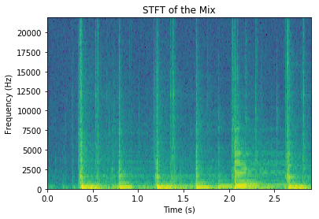
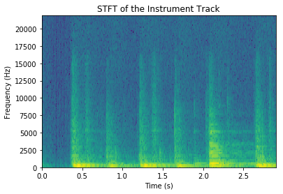
STFT
The Input Mixture
The Output Target

Slide 7
Convolutional Model
Keras
Parameters
model_in = Input(shape=mix_train.shape[1:])
conv_1 = Conv1D(128, 32, …)(model_in)
transpose_1 = Permute((2,1))(conv_1)
fc_1 = Dense(128, …)(transpose_1)
transpose_2 = Permute((2,1))(fc_1)
model_out = Dense(2)(transpose_2)
model = Model(model_in, model_out)
input_1 (InputLayer) (None, 128, 2) 0
conv1d_1 (Conv1D) (None, 128, 128) 8320
permute_1 (Permute) (None, 128, 128) 0
dense_1 (Dense) (None, 128, 128) 16512
permute_2 (Permute) (None, 128, 128) 0
dense_2 (Dense) (None, 128, 2) 258
Total params: 25,090 Trainable params: 25,090 Non-trainable params: 0

Slide 8
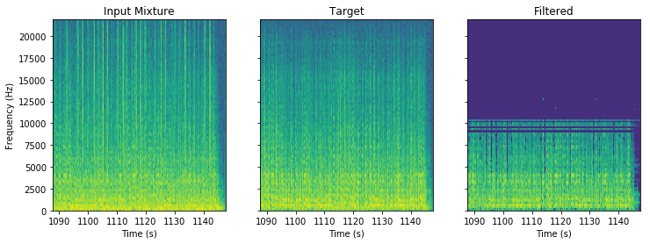

Result on Test Data

